Slide 1
Automatic Watering System for Smart Farm
EE3705: Microprocessor and Microcontroller

Slide 2
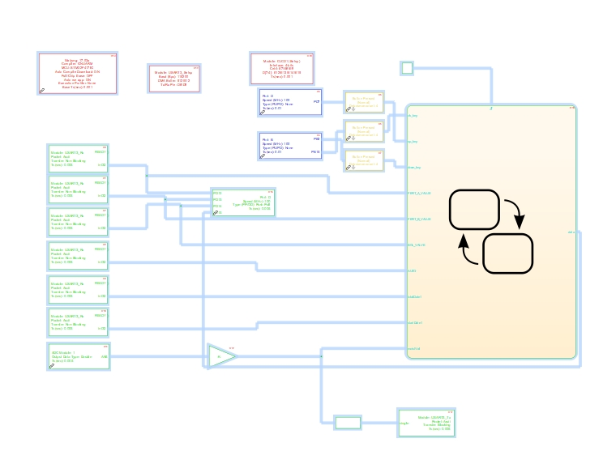
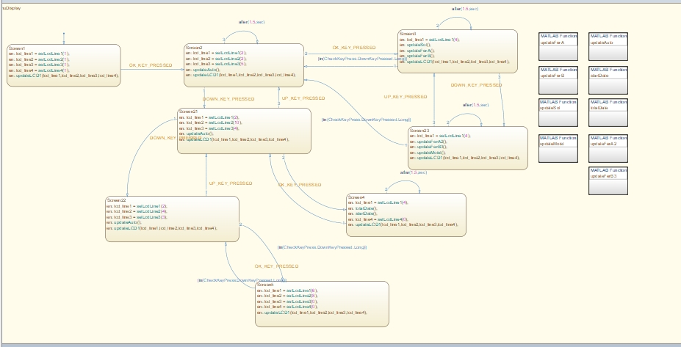
MSTM32F4 with MathLab:

Slide 3
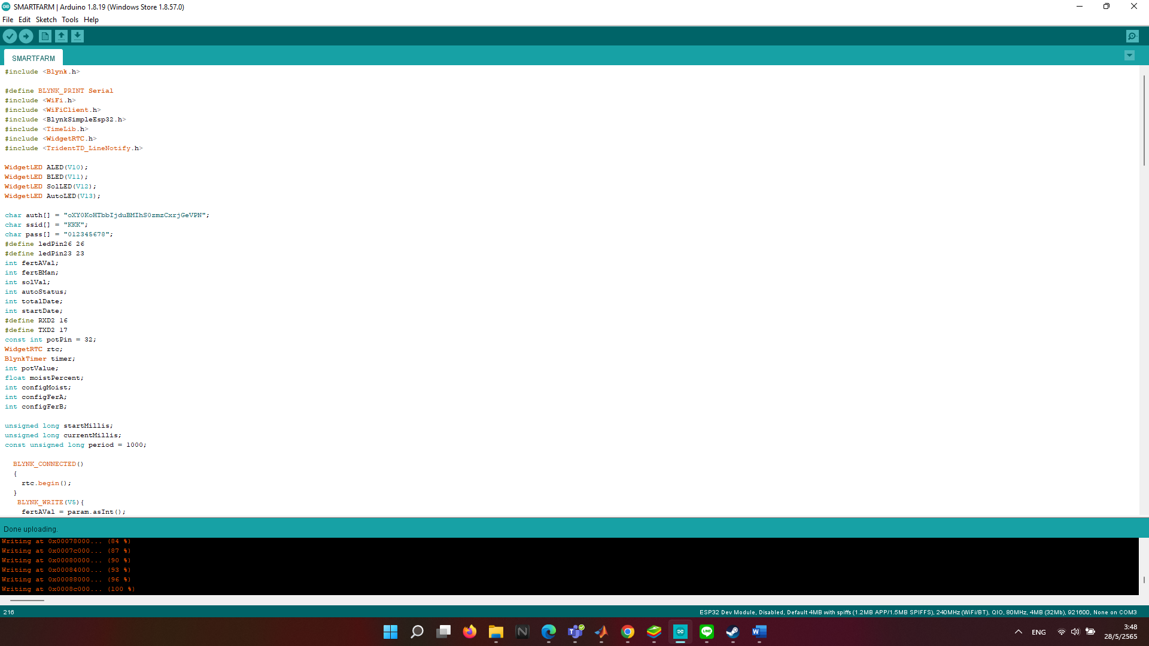
ESP32 with Arduino :

Slide 4
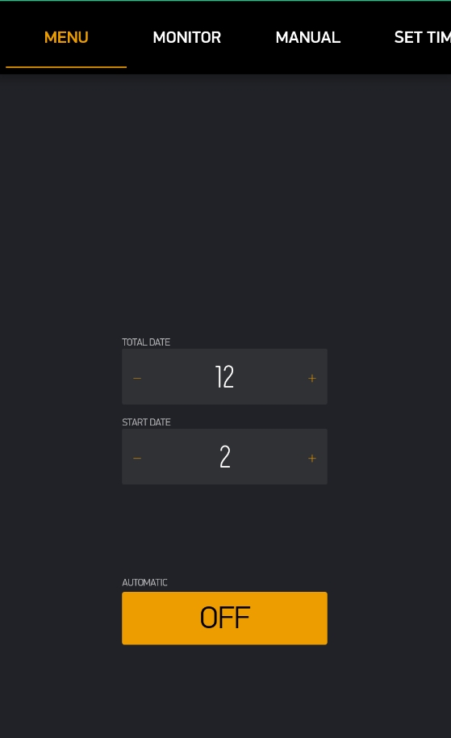
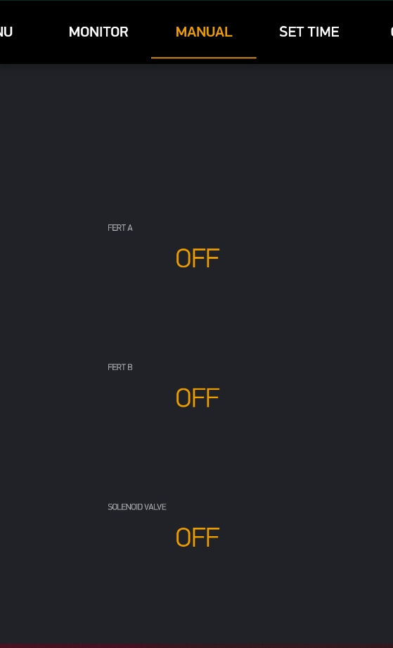
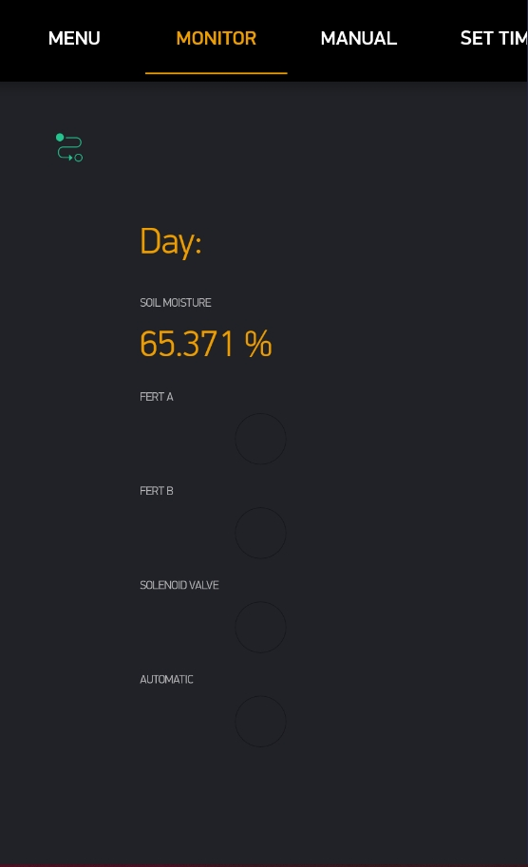
Blynk Application :

Slide 5
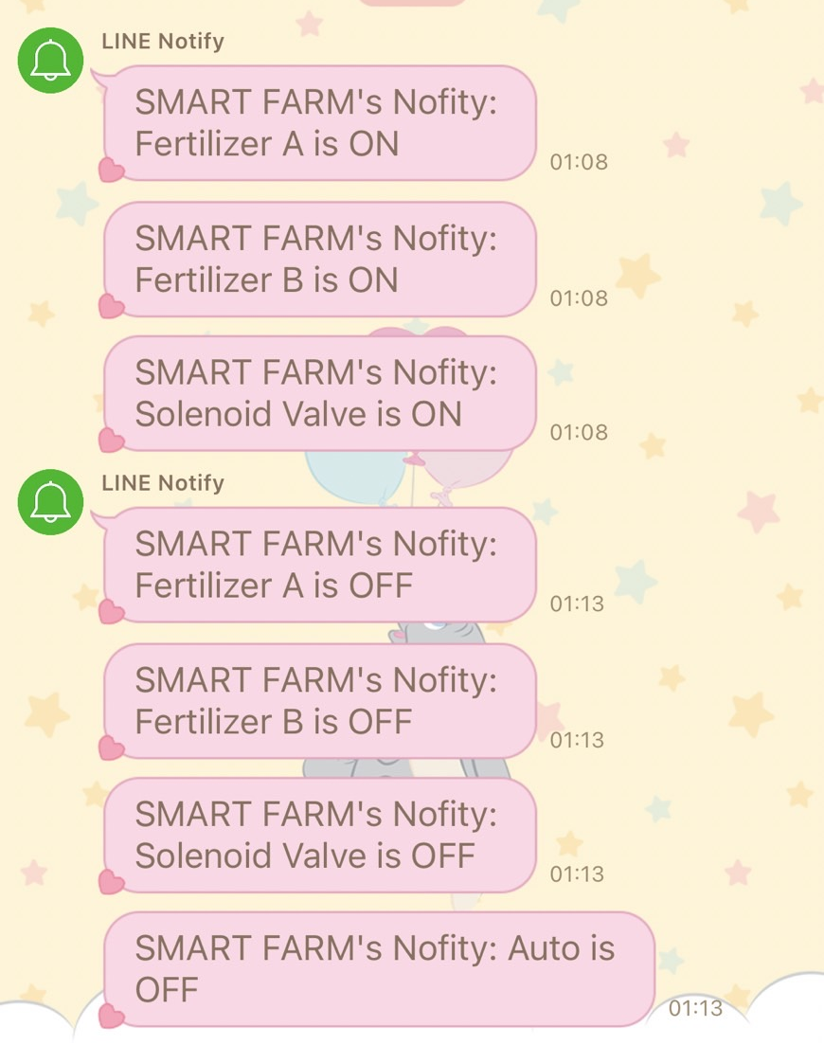
LINE Notify:

Slide 6
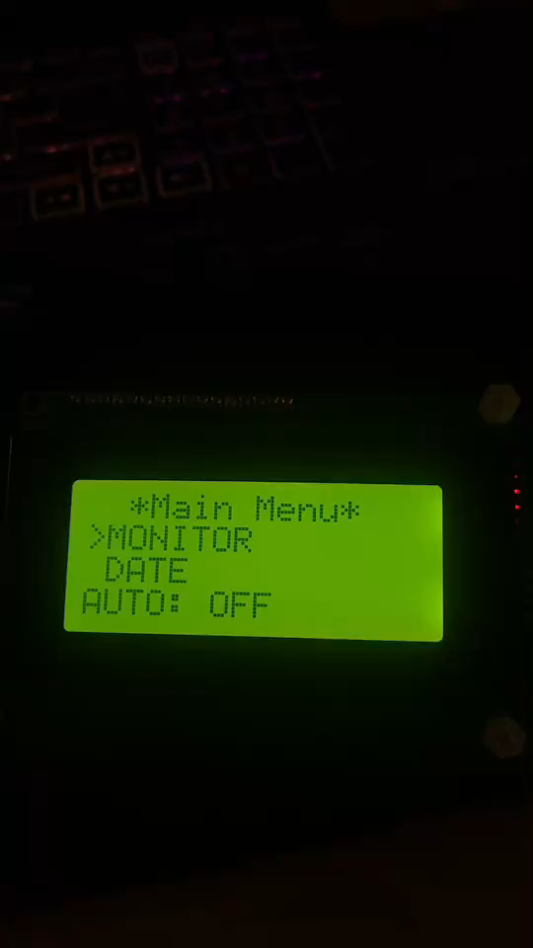
https://drive.google.com/file/d/1neZRWJS9DmexH-pNydCytojxXrMVnquk/view?usp=sharing

